Slide 1

Web Development 1
Forms in HTML5

Slide 2

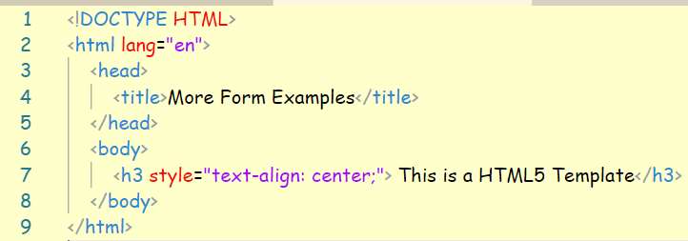
HTML5 Template

Slide 3
Field Patterns

Slide 4
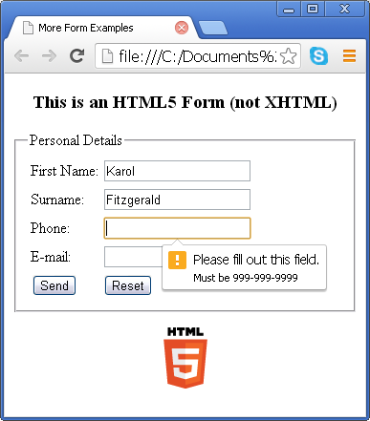
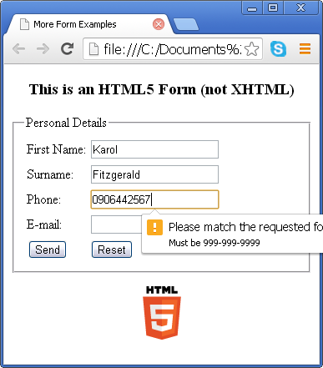
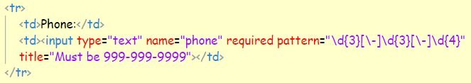
Phone Number

Slide 5
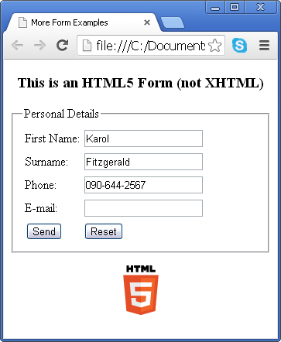
Phone Number

Slide 6
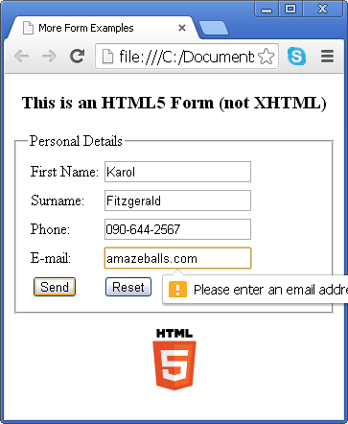
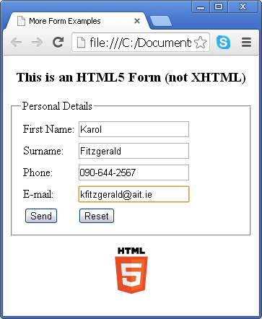
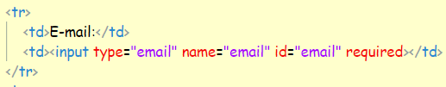
Email Addresses

Slide 7
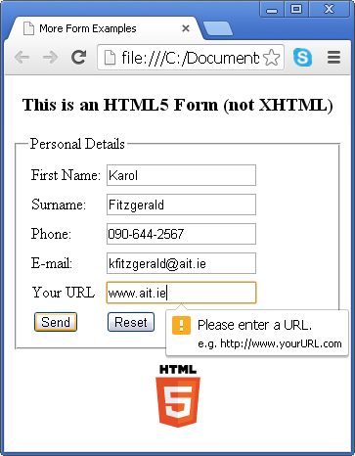
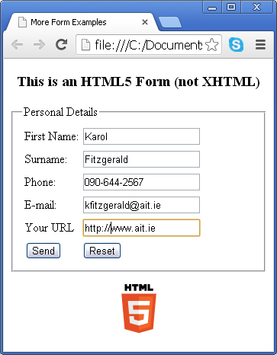

Web Pages (URL)

Slide 8
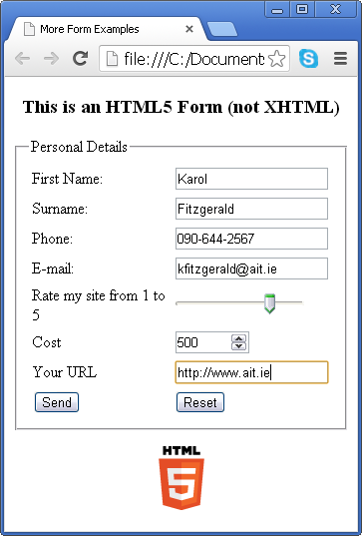
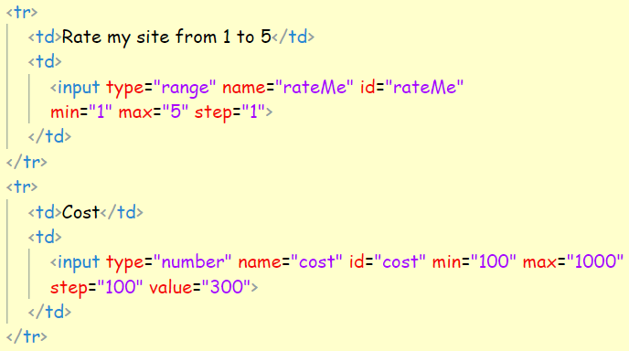
Ranges

Slide 9
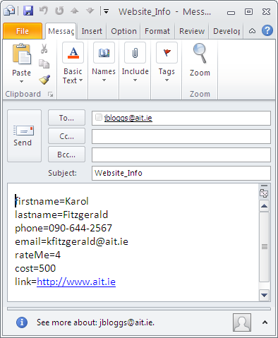

Slide 10
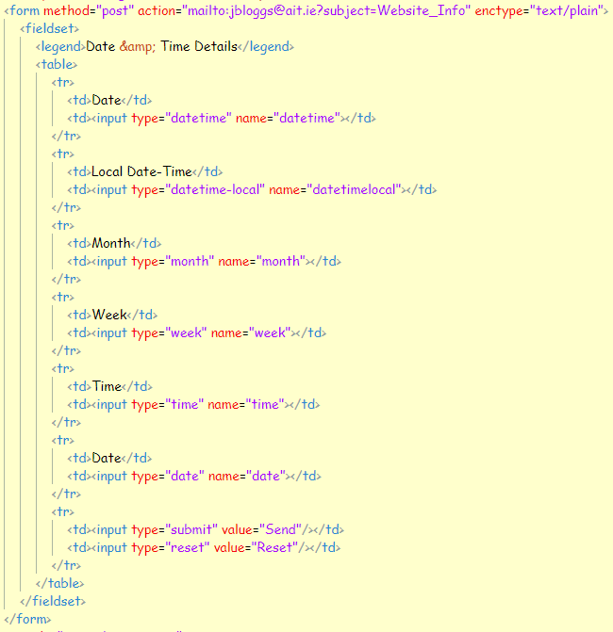
Date-Time

Slide 11
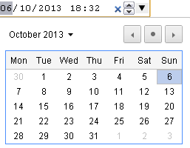
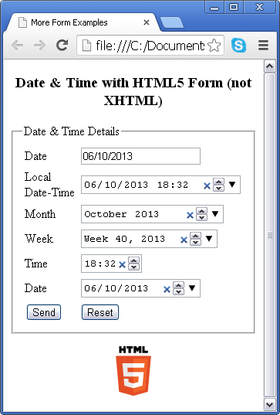
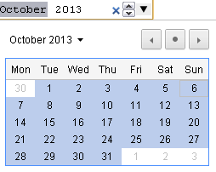
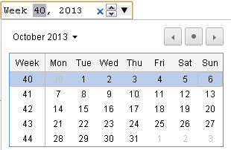
Date - Time
Local
Month
Week

Slide 12
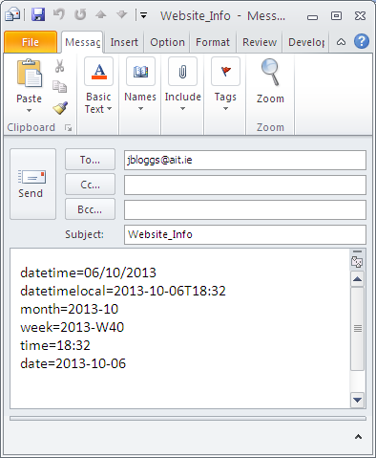

Slide 13
Autocomplete & id
Fills out fields based on previously entered data
Security/privacy issues
To disable use
autocomplete="off“
This id attribute will be discussed when we start CSS3

Slide 14
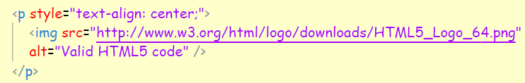
Exercise
Using the HTML5 template provided on Moodle, create and validate the HTML5 form on the next slide
Include the autocomplete and title attributes for the different fields
Include the date type input field
All fields are required
Once you have validated your form add the HTML5 tag using the following code

Slide 15
